Slide 1
Parallel Platforms
Lecture 2

Slide 2
Physical Organization
of Parallel Platforms

Slide 3
Architecture of an Ideal Parallel Computer
Parallel Random Access Machine (PRAM) is an extension of the Random Access Machine (RAM) serial architecture.
PRAMs consist of p processors and a global memory of unbounded size that is uniformly accessible to all processors.
Processors share a common clock but may execute different instructions in each cycle.

Slide 4
Depending on how simultaneous memory accesses are handled, PRAMs can be divided into four subclasses.
  Exclusive-read, exclusive-write (EREW) PRAM.
  Concurrent-read, exclusive-write (CREW) PRAM.
  Exclusive-read, concurrent-write (ERCW) PRAM.
  Concurrent-read, concurrent-write (CRCW) PRAM.

Slide 5
Concurrent write protocols:
Common: write only if all values are identical.
Arbitrary: write the data from a randomly selected processor.
Priority: follow a predetermined priority order.
Sum: Write the sum of all data items.

Slide 6
Complexity of PRAM
Processors and memories are connected via switches.
System of p processors and m words, the switch complexity is O(mp).
Clearly, for practical values of p and m, a true PRAM is not realizable.

Slide 7
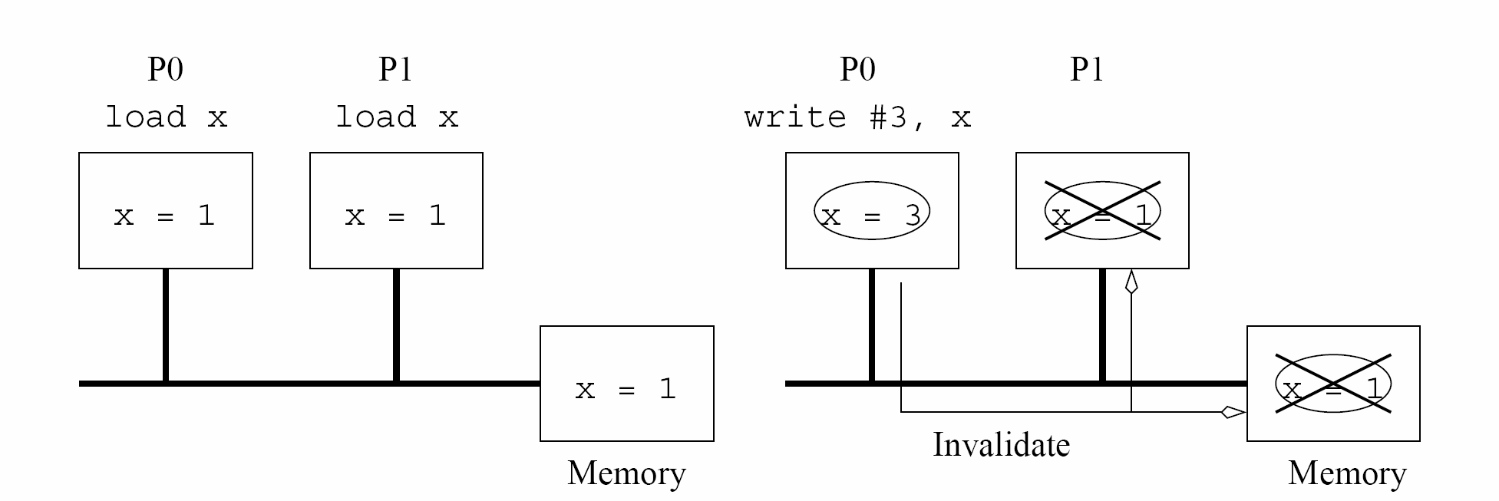
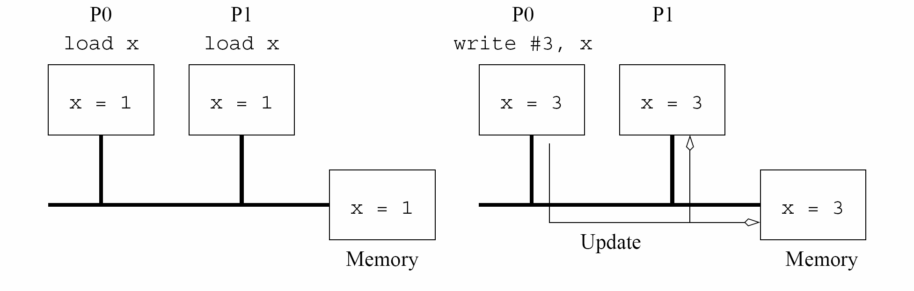
Cache Coherence
in Multiprocessor Systems
Invalidate protocol
Update protocol

Slide 8
Maintaining Coherence
Using Invalidate Protocols
Three-State cache coherence protocol
Shared state: there are multiple valid copies of the data item (and therefore, an invalidate would have to be generated on an update).
Dirty state: only one copy exists and therefore, no invalidates need to be generated.
Invalid state: the data copy is invalid, therefore, a read generates a data request (and associated state changes).

Slide 9
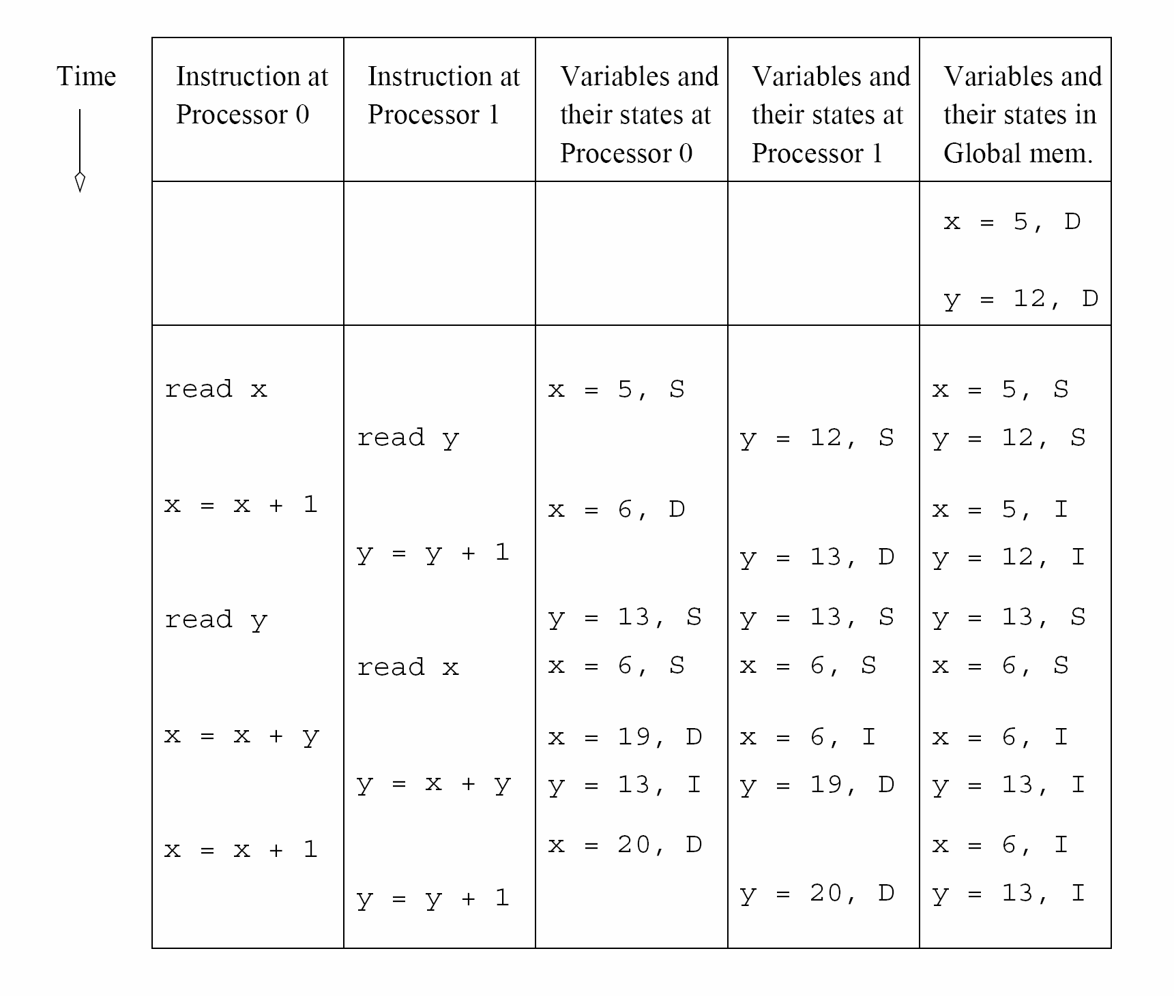
Example of parallel program execution with the simple
three-state coherence protocol.

Slide 10
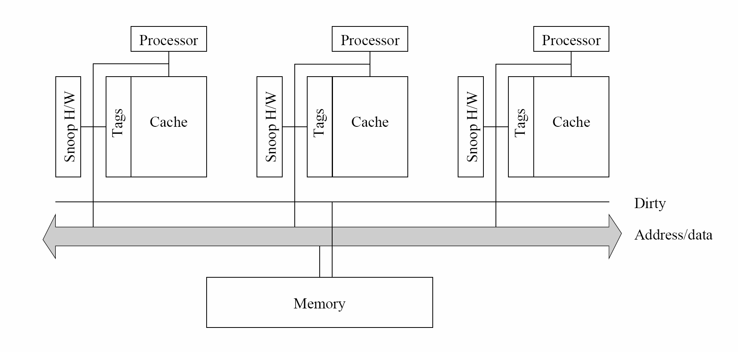
Snoopy Cache Systems

Slide 11
Performance of Snoopy Caches
A dirty copy → all subsequent operations can be performed locally on the cache without generating external traffic.
A shared copy→ all subsequent read operations become local.
A coherence requests → If processors read and update data at the same time
( bandwidth limited )

Slide 12
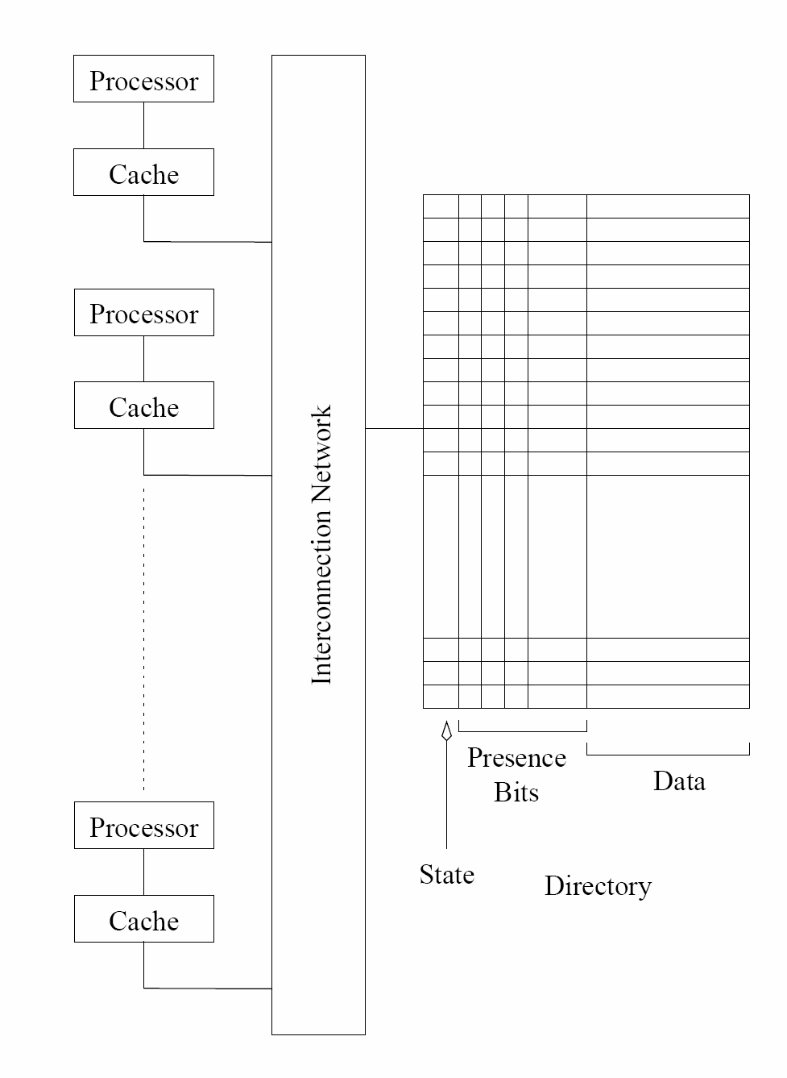
Directory Based
Systems

Slide 13
Performance of Directory Based Schemes
The additional bits to store the directory may add overhead.
The network must be able to carry all the coherence requests.
The directory is a point of contention, therefore, distributed directory schemes must be used.

Slide 14
Interconnection Networks
for Parallel Computers
Interconnection networks carry data between processors nodes.
Interconnects are made of switches and links (wires, fiber).
Interconnections are classified as static or dynamic.
Static networks consist of point-to-point communication links among processing nodes and are also referred to as direct networks.
Dynamic networks are built using switches and communication links. Dynamic networks are also referred to as indirect networks.

Slide 15
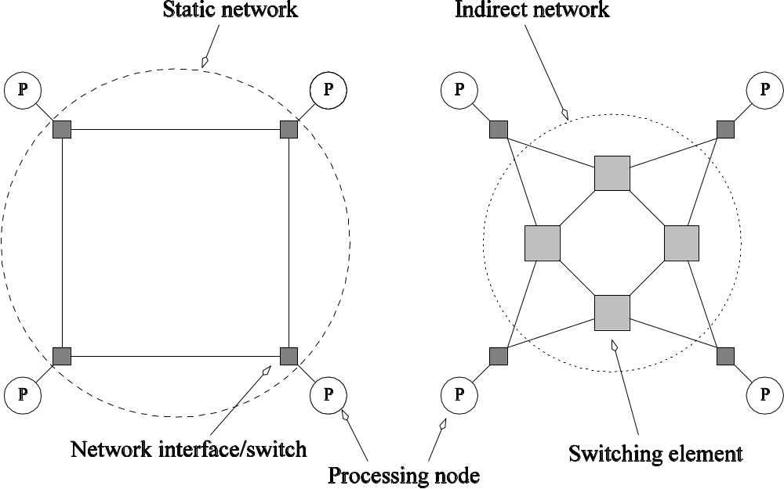
Static and Dynamic
Interconnection Networks
Static Network
Dynamic Network

Slide 16
Switch
Switch is an interconnection network consists of a set of input and output ports
Switch functions
  Mapping from the input to the output ports
  Switch may support
    Internal buffering (when the requested output port is busy)
    Routing (to alleviate network congestion)
    Multicast (same output on multiple ports)
Switch degree: total number of ports

Slide 17
Network Topologies
Bus-Based Networks
Crossbar Networks
Multistage Networks
Completely-Connected Networks
Star-Connected Networks
Linear Array, Meshes, and k-D Meshes
Tree-Based Networks

Slide 18

Evaluating
Static Interconnection Networks
Diameter: The maximum distance between any two processing nodes in the network.
  The distance between any two nodes is defined as the shortest path (in term of number of links) between them.
Connectivity: a measure of the multiplicity of paths between any two processing nodes.
  Arc connectivity : minimum number of arcs that must be removed to break it into two disconnected networks.
Bisection Width: The minimum number of wires you must cut to divide the network into two equal parts.
Cost: one way of defining the cost is number of communication links.

Slide 19
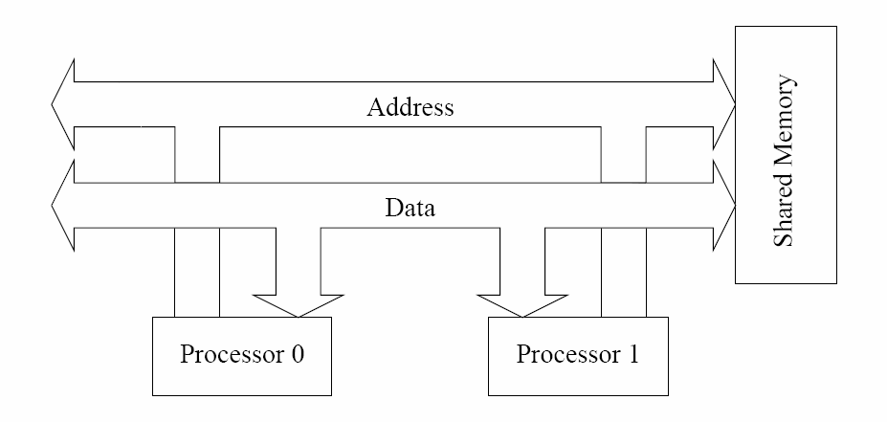
Bus-Based Networks
All processors access a common bus for exchanging data.
The distance between any two nodes is O(1) in a bus.
Bus also provides a convenient broadcast media.
Bandwidth of the shared bus is a major bottleneck.
Performance can be enhanced using cache
Typical bus based machines are limited to dozens of nodes.

Slide 20
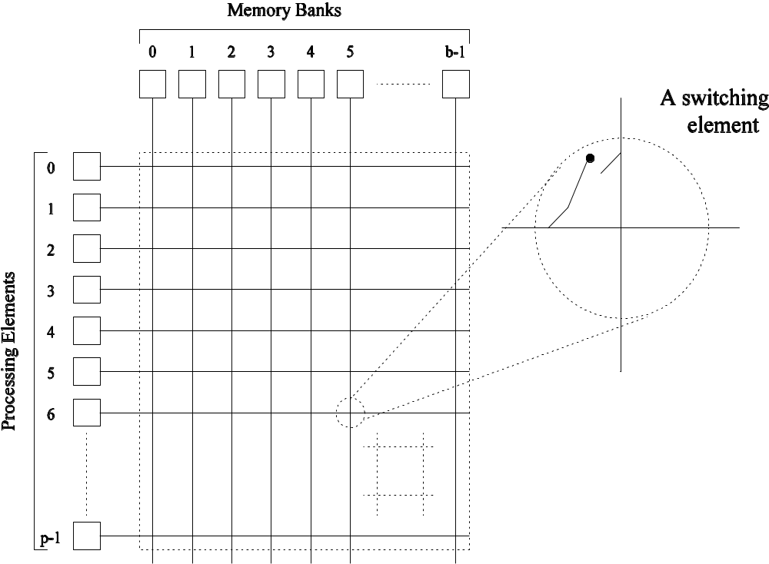
Crossbar Networks
A crossbar network uses an p×m grid of switches to connect p inputs to m outputs in a non-blocking manner.
The cost of a crossbar of p processors grows as O(p²).

Slide 21
Scalability
Scalability | Performance | Cost
Bus-Based Networks | poor | excellent
Crossbar Networks | excellent | poor

Slide 22
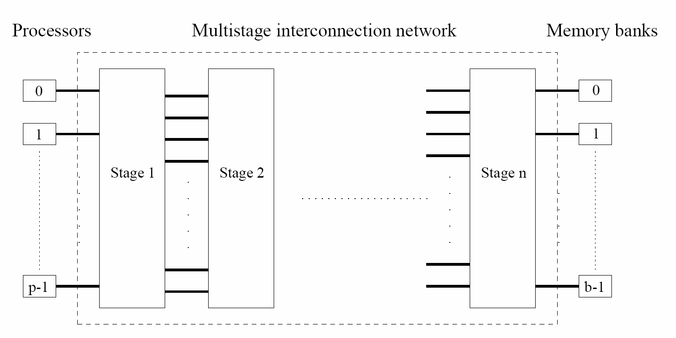
Multistage Networks

Slide 23
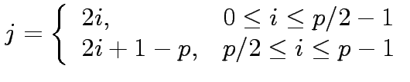
Multistage Omega Network
This network consists of log p stages, where p is the number of inputs/outputs.
At each stage, input i is connected to output j if:

Slide 24
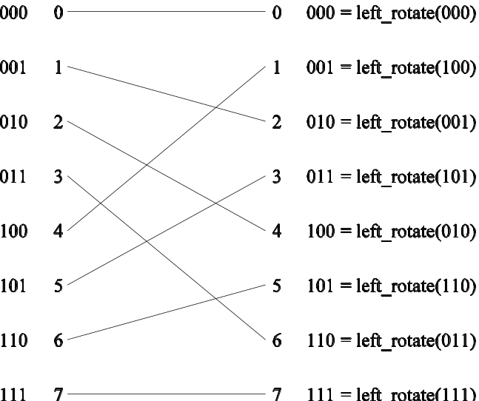
Each stage of the Omega network implements a perfect shuffle as follows:
A perfect shuffle interconnection for eight inputs and outputs.

Slide 25
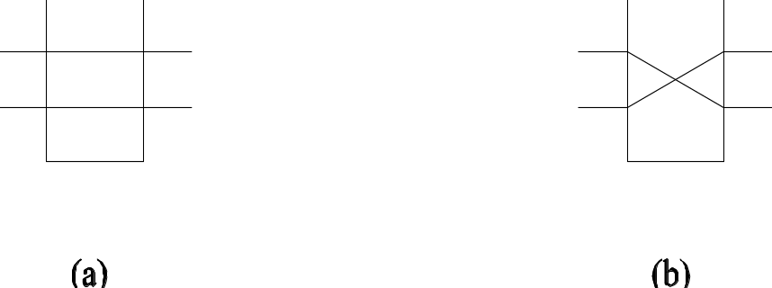
Switches of Omega Network
The perfect shuffle patterns are connected using 2×2 switches.
The switches operate in two modes:
Pass-through
Cross-over.

Slide 26
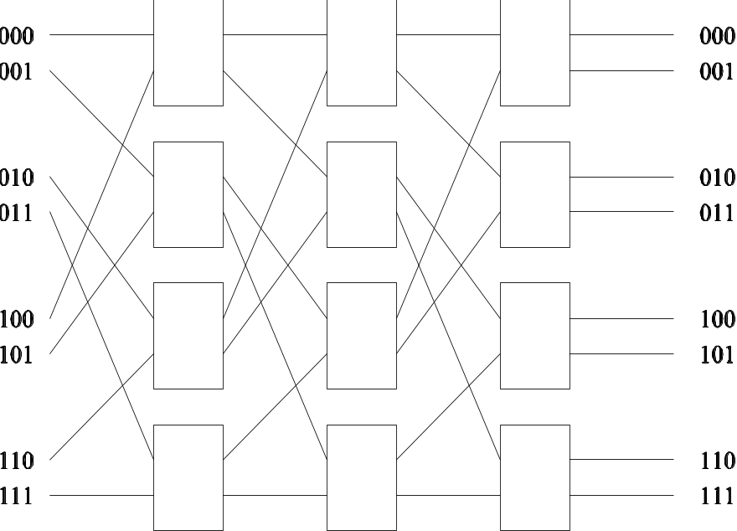
8 x 8 Omega Network
An omega network has p/2 × log p switching nodes, and the cost of such a network grows as O(p log p).

Slide 27
Omega Network – Routing
Let s be the binary representation of the source and d be that of the destination processor.
The data traverses the link to the first switching node. If the most significant bits of s and d are the same, then the data is routed in pass-through mode by the switch else, it switches to crossover.
This process is repeated for each of the log p switching stages.

Slide 28
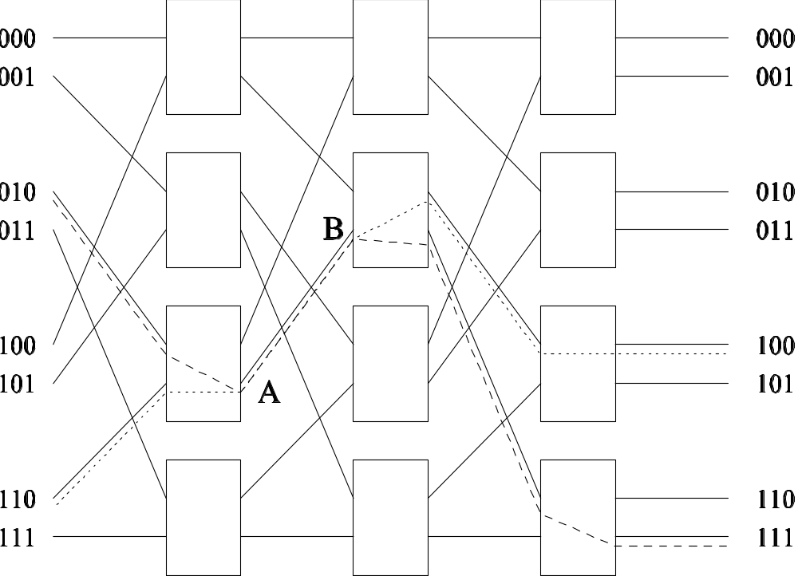
Blocking Omega Network – Example
one of the messages (010 to 111 or 110 to 100) is blocked at link AB.

Slide 29
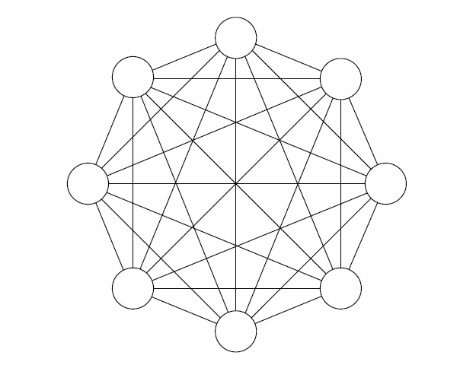
Completely-Connected Networks
Each processor is connected to every other processor.
The number of links in the network scales as O(p²).
While the performance scales very well, the hardware complexity is not realizable for large values of p.

Slide 30
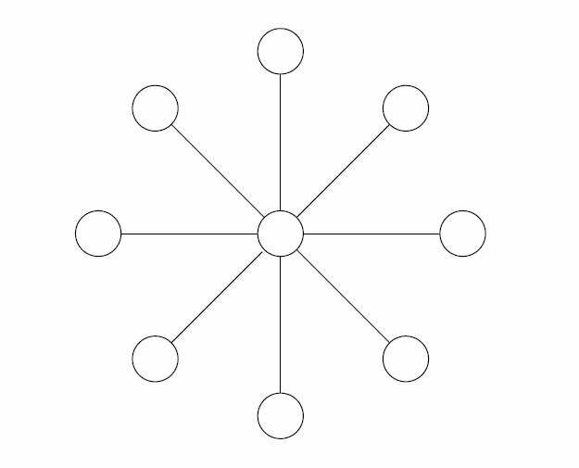
Star-Connected Networks
Every node is connected only to a common node at the center.
Distance between any pair of nodes is O(1). However, the central node becomes a bottleneck.
In this sense, star connected networks are static counterparts of buses.

Slide 31
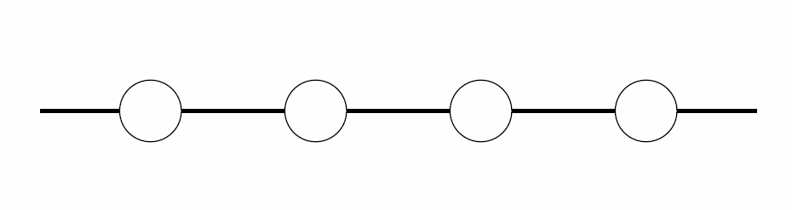
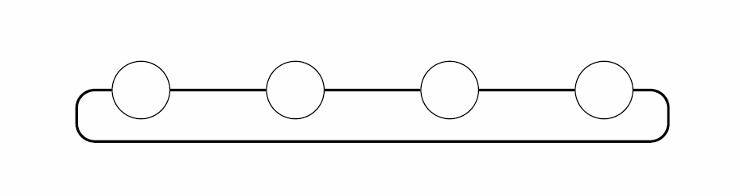
Linear Array, Meshes, and k-D Meshes
linear array: each node has two neighbors, one to its left and one to its right.
1-D torus or a ring: If the nodes at either end of a linear array are connected
Linear array
1-D torus (Ring)

Slide 32
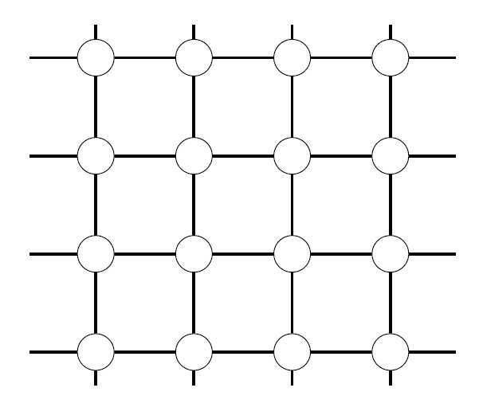
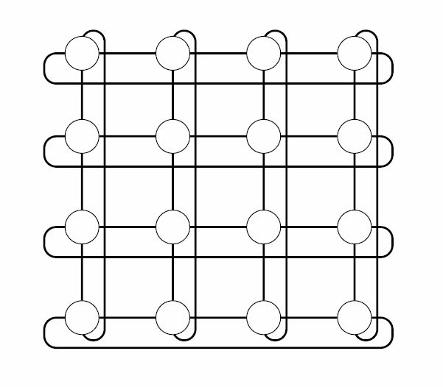
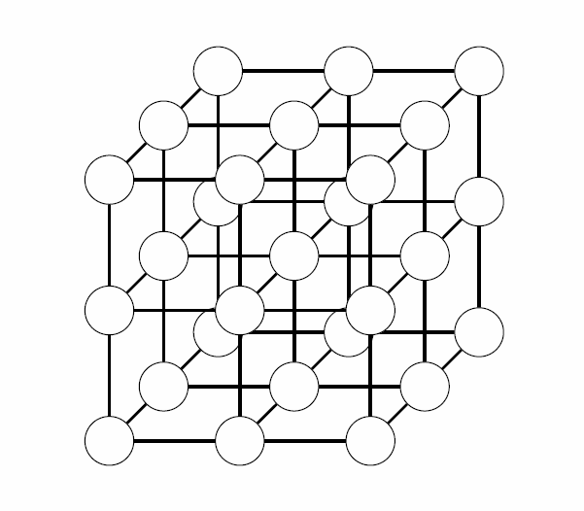
Two- and Three Dimensional Meshes
2-D mesh with no wraparound
2-D mesh with wraparound
(2-D torus)
3-D mesh with no wraparound

Slide 33
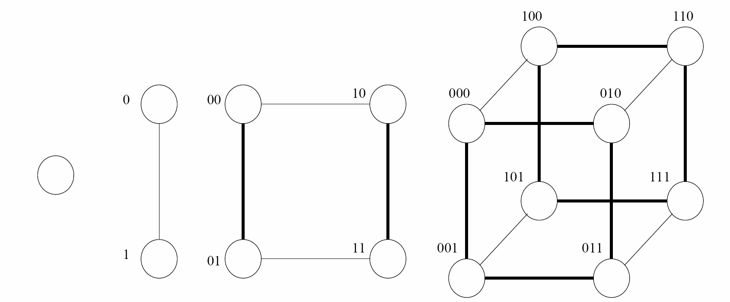
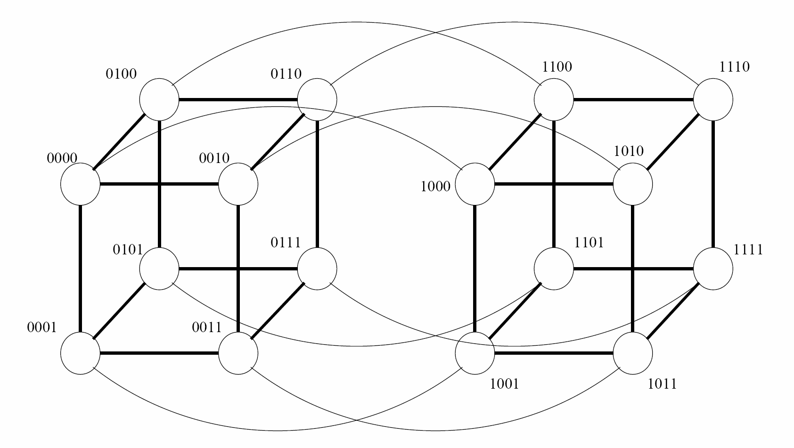
Hypercube
0-D hypercube
1-D hypercube
2-D hypercube
3-D hypercube
4-D hypercube

Slide 34
Properties of Hypercubes
The distance between any two nodes is at most log p.
Each node has log p neighbors.
The distance between two nodes is given by the number of bit positions at which the two nodes differ.

Slide 35
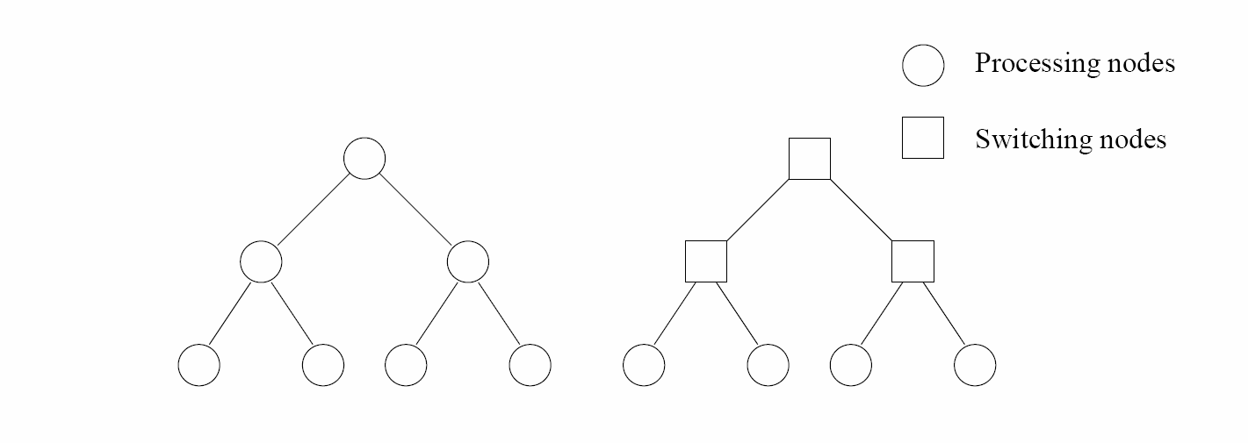
Tree-Based Networks
Static Tree Network
Dynamic Tree Network

Slide 36
Tree Properties
The distance between any two nodes is no more than 2logp.
Links higher up the tree potentially carry more traffic than those at the lower levels.
For this reason, a variant called a fat-tree, fattens the links as we go up the tree.

Slide 37
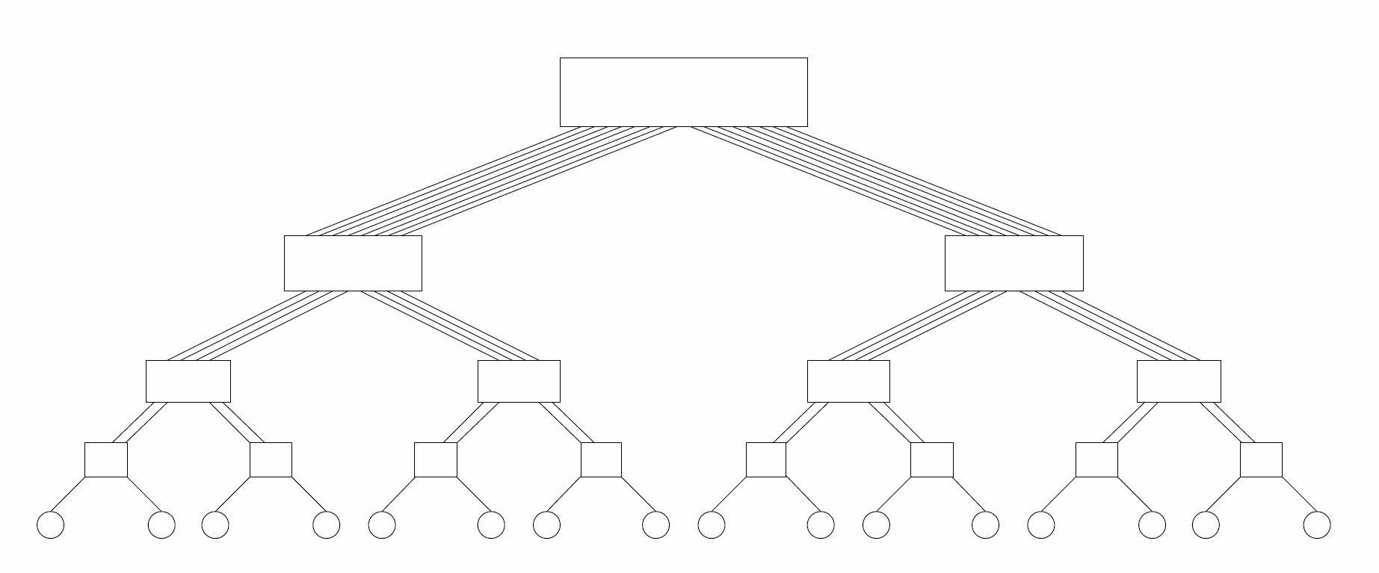
Fat-Tree
A fat tree network of 16 processing nodes.

Slide 38
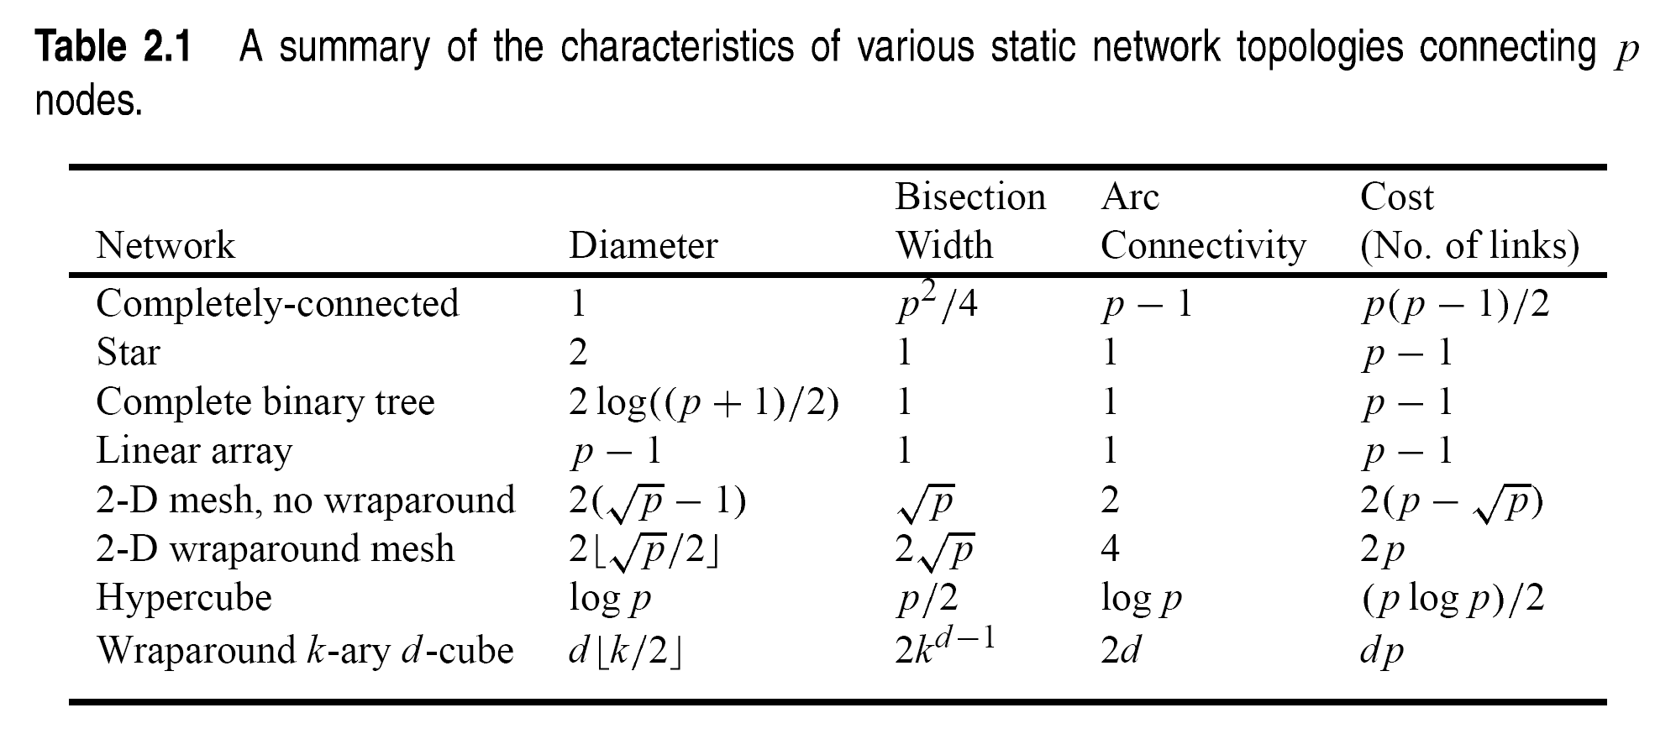

Slide 39
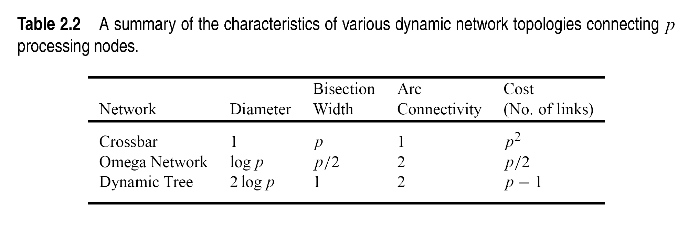

Slide 40
Message Passing Costs in
Parallel Computers
The principal parameters that determine the communication latency (cost) are as follows:
Startup time (t_{s}): the time required to handle a message at the sending and receiving nodes
Per-hop time (t_{h}): This time is a function of number of hops and includes factors such as switch latencies, network delays, etc.
Per-word transfer time (t_{w}): This time includes all overheads that are determined by the length of the message. This includes bandwidth of links, error checking and correction, etc.

Slide 41


Store-and-Forward Routing
A message traversing multiple hops is completely received at an intermediate hop before being forwarded to the next hop.
The total communication cost for a message of size m words to traverse l communication links is
In most platforms, t_{h} is small and the above expression can be approximated by

Slide 42
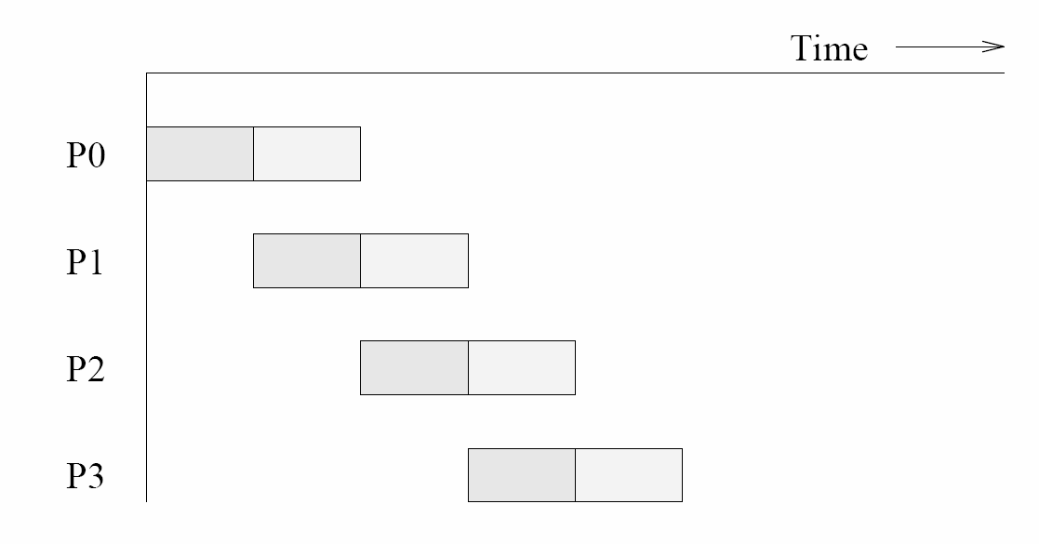
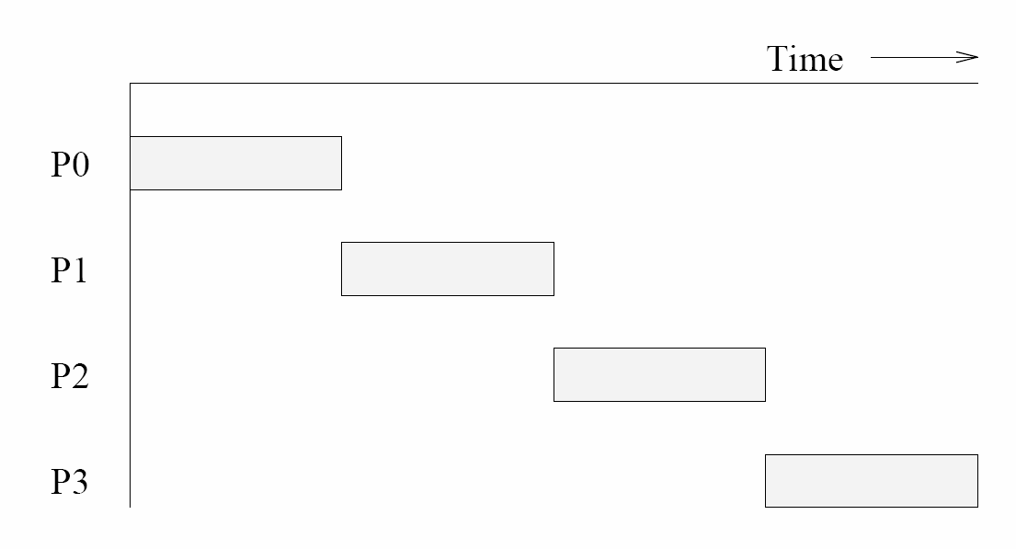
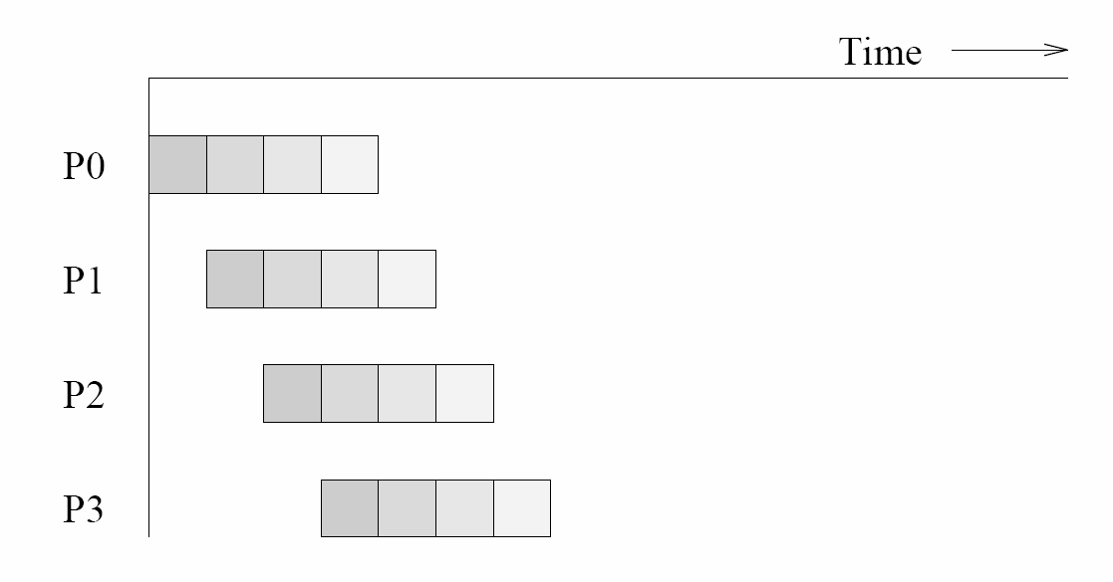
Packet Routing
The same message broken into two parts
A single message sent over a store-and-forward Network
The same message broken into four parts

Slide 43
Packet Routing Advantages
Better utilizing communication resources
lower overhead packet loss (error)
Possibility of taking different paths
Better error correction capability
Packet Routing Overhead
Each packet must carry
  Routing information
  Error correction information
  Sequencing information

Slide 44
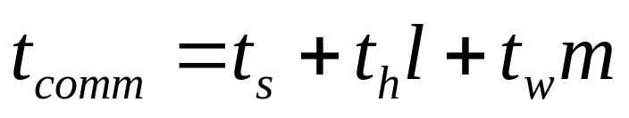
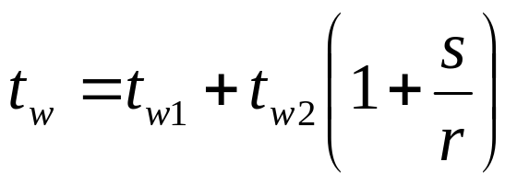
Packet Routing comm., time
The total communication time for packet routing is approximated by:
Where :
  r is the original message
  s is the additional data information
  t_{w1} packetizing time
  t_{w2} word communication time

Slide 45
Cut-Through Routing
Takes the concept of packet routing
  Divide messages into basic small units called flits.
    header information is minimized.
This is done by forcing all flits to:
  take the same path, in sequence.
  A tracer message first programs all intermediate routers and all flits then take the same route.
  Error checks are performed on the entire message
  No sequence numbers are needed.

Slide 46

The total communication time for cut-through routing is approximated by:
This is identical to packet routing, however, t_{w} is typically much smaller.

Slide 47


Simplified Cost Model for Communicating Messages
The communication time in Cut-through routing is :
t_{h} is typically smaller than t_{s} and t_{w} when m is large.
Time can approximated as follows:

Slide 48
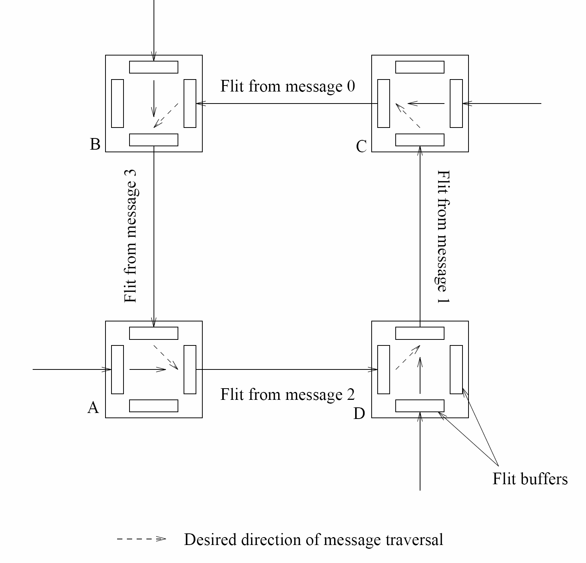
Deadlock in cut-through network

Slide 49
Routing Mechanisms for Interconnection Networks
Routing Mechanism: determines the path a message takes through the network to get the message from source to destination
Mechanism Input:
  source, destination nodes
  May be, state of the network information
Mechanism Output:
  One or more paths

Slide 50
Routing Mechanisms Classifications
Minimal: selects one of the shortest paths
  Advantage: each link brings a message closer to its destination.
  Disadvantage: can lead to congestion
Non-Minimal: may route the message along longer path to avoid network congestion

Slide 51
Routing Mechanisms Classifications on the base of using network stat information
Deterministic Routing: determines a unique path for the message based on its source and destination.
Adaptive Routing: uses information regarding the current state of the network
  Detect congestion and route the message around it

Slide 52
Dimension Ordered Routing
Is a deterministic minimal routing technique that assigns successive channels based on numbering scheme
XY-routing → two dimensional mesh.
E-cube routing → hypercube

Slide 53
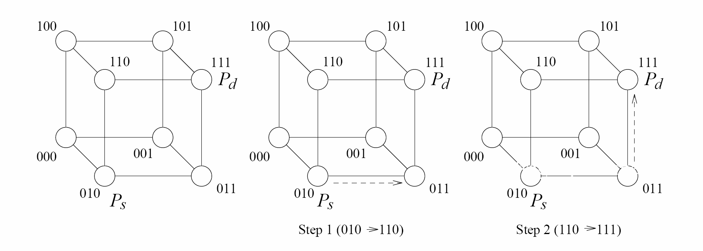
E-cube routing
Distance between P_{s} and P_{d} = # of 1s in (010 ⊕ 111) = # of 1s in (101) = 2
1st rout → (010 ⊕ 111) = (101) → 011
2nd rout → (011 ⊕ 111) = (100) → 111

Slide 54
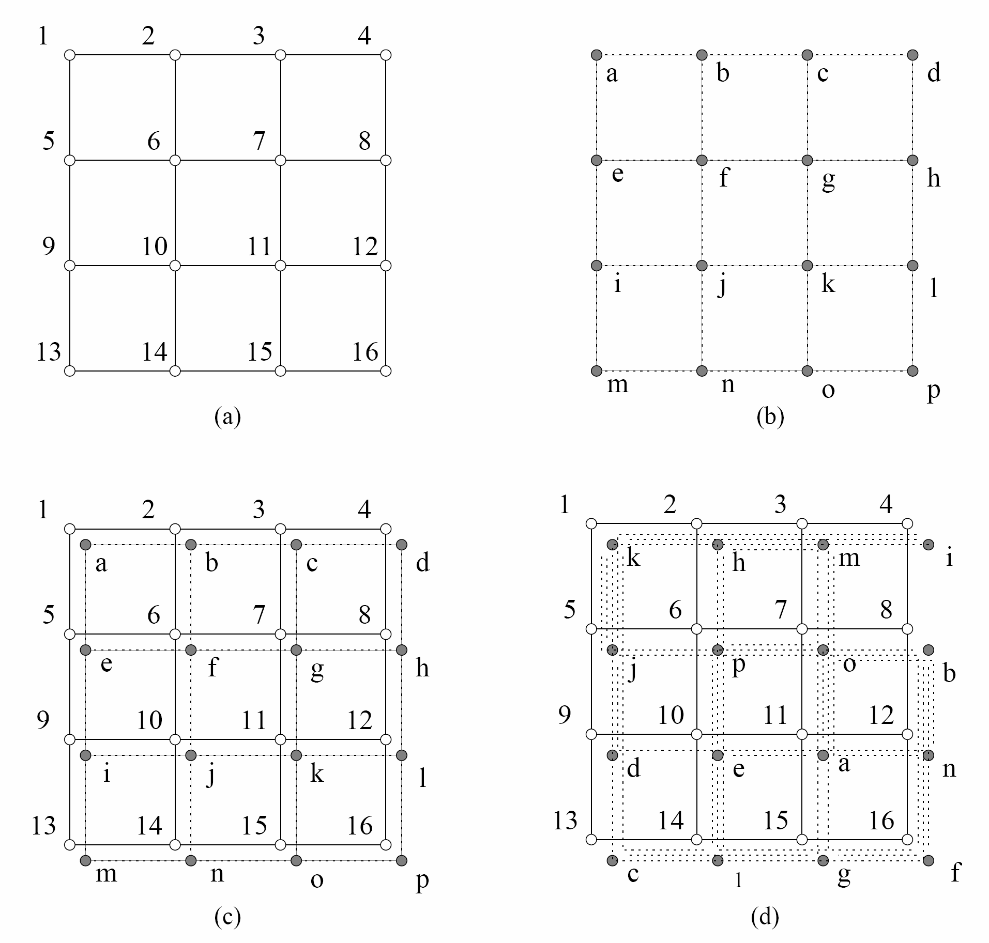
Impact of process-processor Mapping and Mapping Techniques

Slide 55
Mapping Techniques for Graphs
Metrics of mapping a graph G(V,E) into G’(V’,E’)
Congestion : the maximum number of edges mapped onto any edge in E’.
Dilation : the maximum number of links in E’ that any edge in E is mapped onto.
Expansion : the ratio of the number of nodes in the set V’ to that in set V.

Slide 56
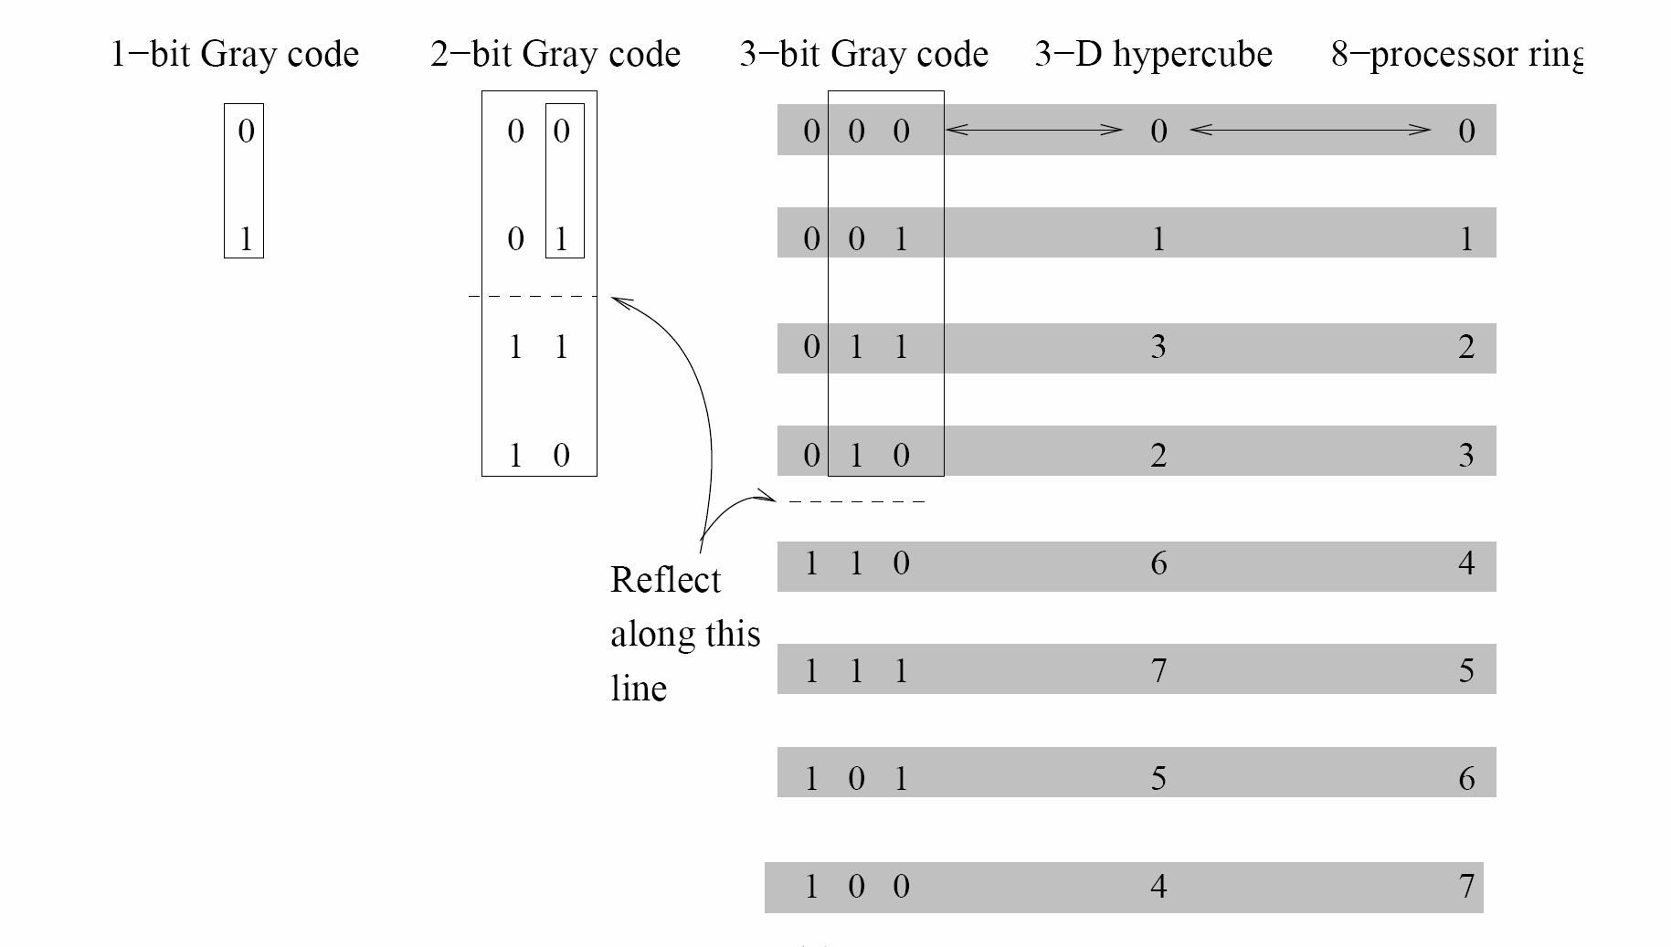
Binary Reflected Gray Code (RGC)

Slide 57
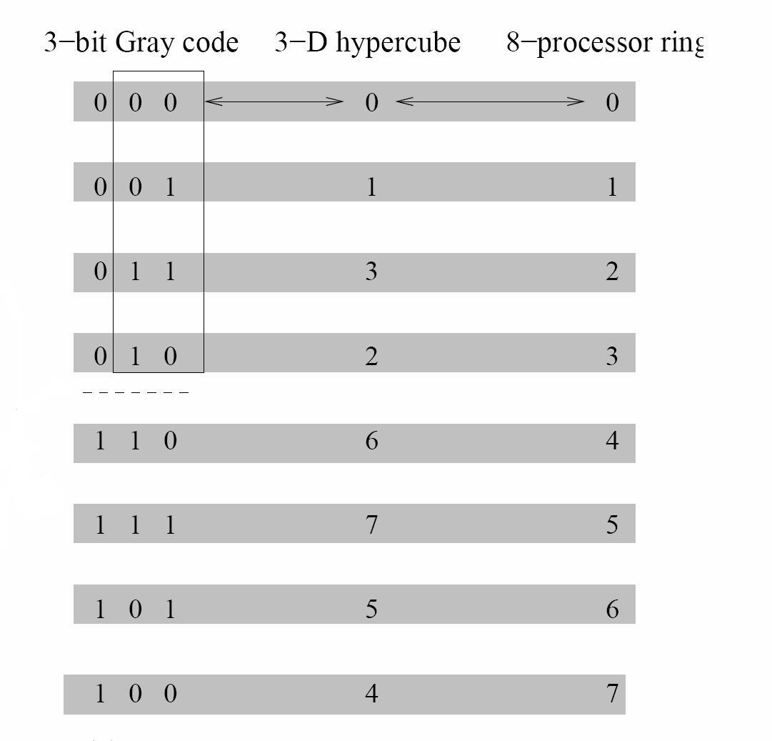
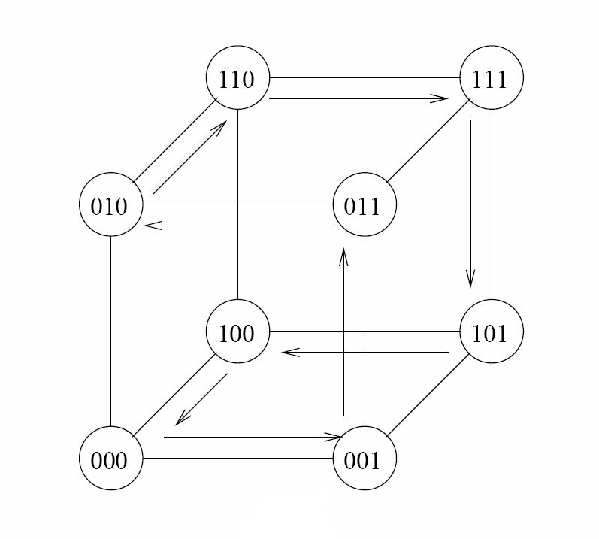
Embedding a Linear Array into a Hypercube

Slide 58
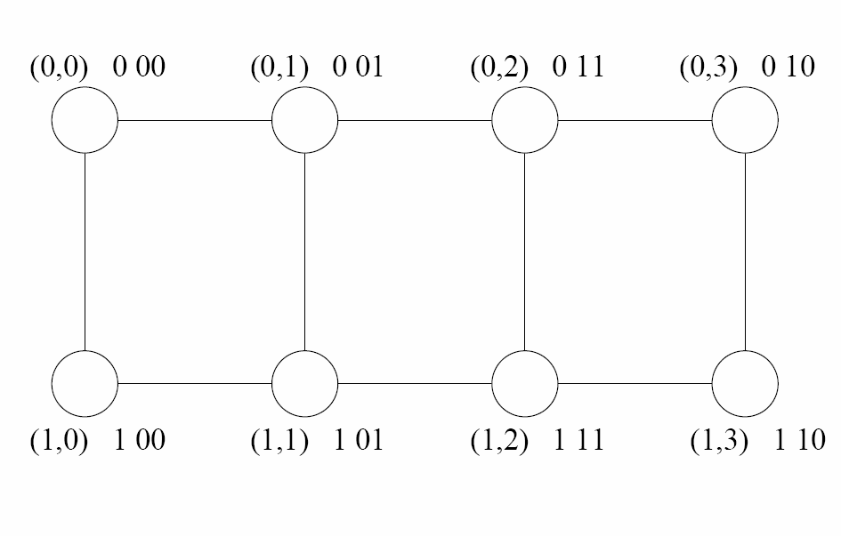
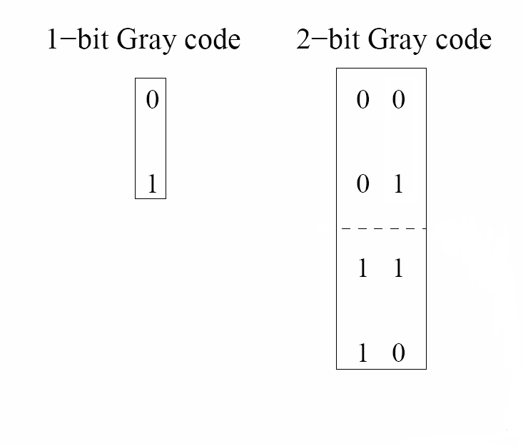
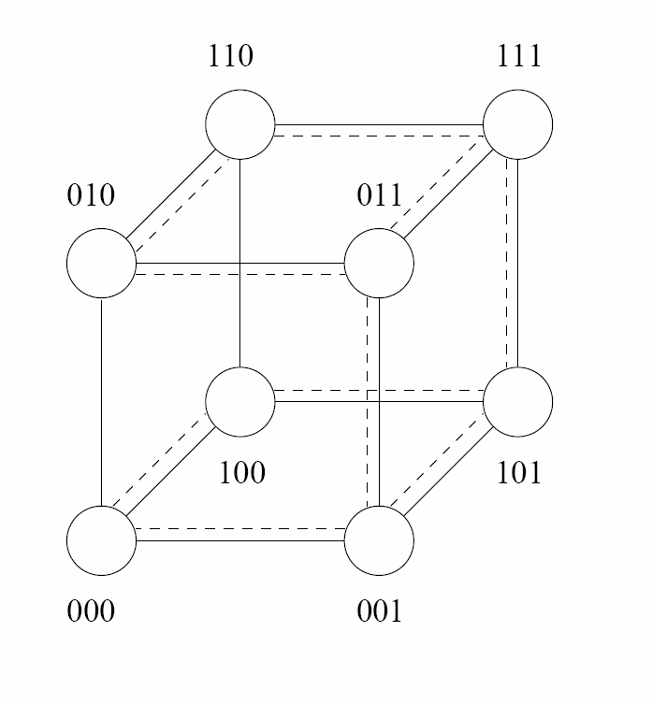
Embedding a Mesh into a hypercube

Slide 59
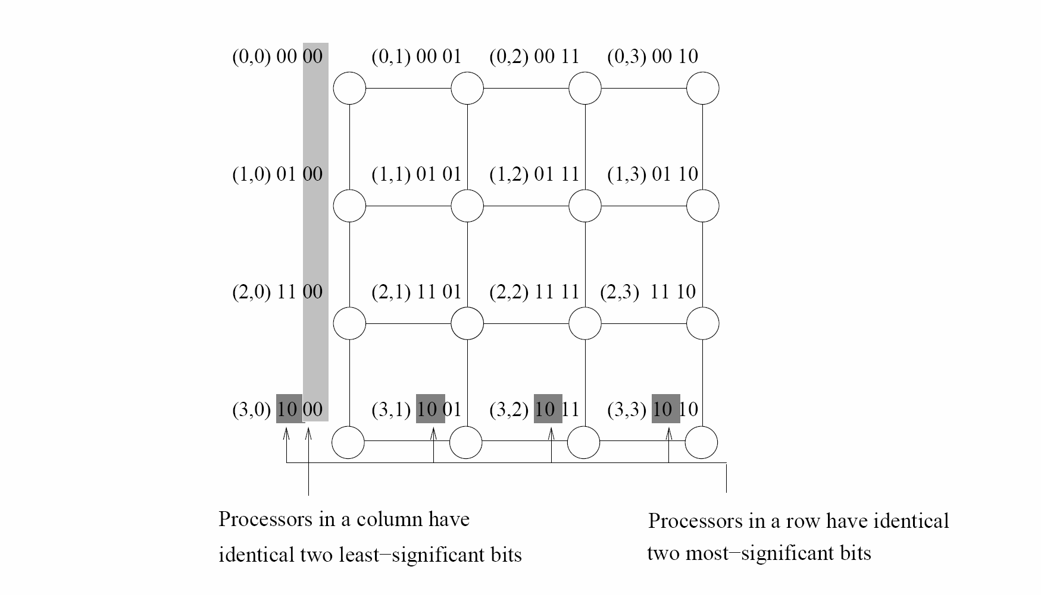
A 4x4 Mesh embedded in
a 4D-Hypercube

Slide 60
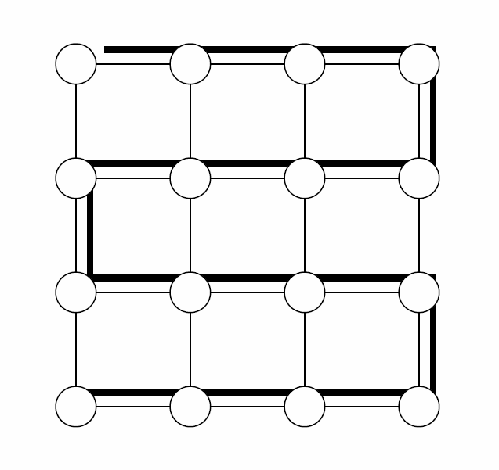
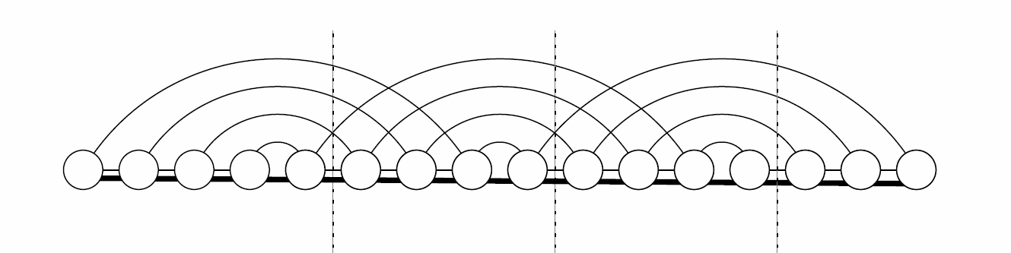
Embedding a Mesh
into a Linear Array
Embedding a 16 node linear array into a 2-D mesh
Embedding a 4x4 mesh into a 16node linear array
  Solid lines correspond to links in the linear array
  Normal lines to links in the mesh.

Slide 61
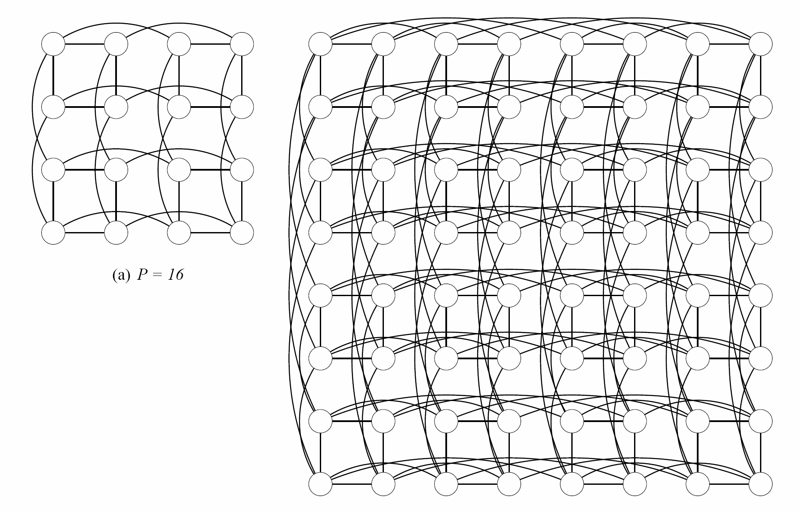
Embedding a Hypercube into a 2-D Mesh

